Slide 1

Commercial Space Risk Management
Comparing FAR & FAA Risk Standards

Slide 2

Overview
Identifying the hazard
Historic Risk
  All Aviation
  Commercial Aviation
Probability of Casualty versus Likelihood of Effect
  Comparative Example: Turbulence
Ideas for Consideration

Slide 3
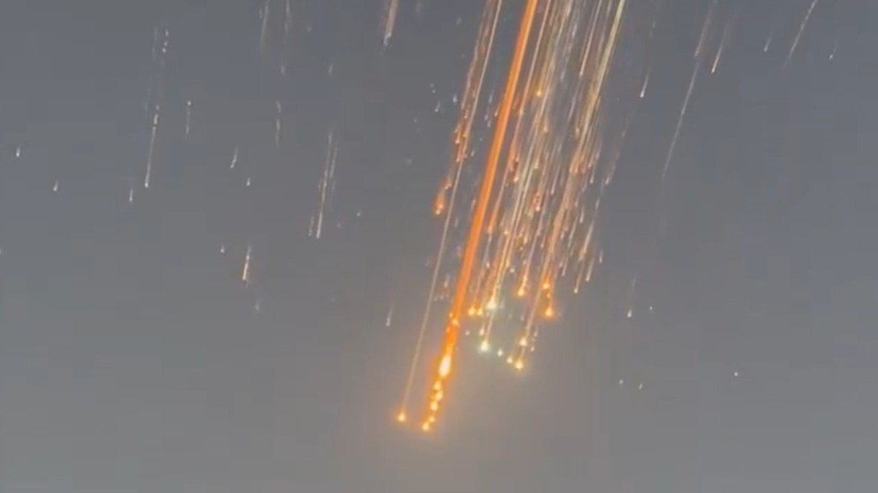
What if it happened tomorrow?
03022055 – Environmental issues – Physical environment – Object/animal/substance – Debris/dirt/foreign object
determine the likelihood of a hazard causing or contributing to an incident or aircraft accident
Risk Analysis
Condition or Object
Cause or contribute
Incident or Aircraft Accident
Investigation
identify the hazard(s) that caused or contributed to the incident or accident
03022055 – Environmental issues – Physical environment – Object/animal/substance – Debris/dirt/foreign object
Notes:
In order to access relevant safety data, especially to answer questions like …
How often has this hazard been cited as causal or contributing to an occurrence in the past?
When this hazard was cited, what was the severity of the outcome in each case?
We must use a common taxonomy.
Important: the common taxonomy is not a stand-alone tool. The codes and standardized text strings are augmented with narratives to provide amplifying information. Hazards can also be made more specific through the use of standardized “modifiers”

Slide 4

Historic Risk 2008-2024
03022055 – Environmental issues – Physical environment – Object/animal/substance – Debris/dirt/foreign object
This hazard’s risk can affect multiple aviation segments
Notes:
FAA Order 8040.4C includes a risk matrix for use in assessing “commercial” risk when applicable. When the conditions for using the commercial matrix are not met, the general matrix is used.
Data begins in 2008 when NTSB adopted the FAA’s standard taxonomy at the FAA’s request. Exposure data and complete investigation reports are not yet available for 2025 or later. The collection of data, risk quantification using the risk framework, and generation of the risk matrix has been automated such that the analysis in this slide can be accomplished in seconds.
Incidents reports in the FAA AIDS database do not include citations to the specific causal or contributing hazards as NTSB reports do. Therefore, the number of occurrences includes a data-driven estimate of the number of incidents.
The severity distribution is derived from the severity of the 118 occurrences and the expected value for historic risk is the observed number of historic events, though the number of severity 4 and 5 “incidents” has some margin of error due to the estimate mentioned above.

Slide 5

Hazard 03022055 – Commercial Only
No incidents or accidents found
ψ
See white paper on “ψ” for explanation

Slide 6
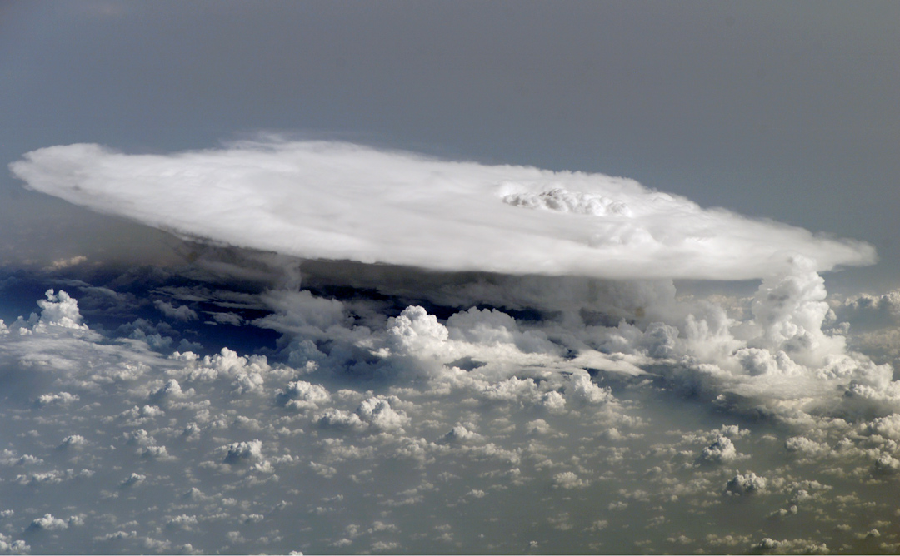
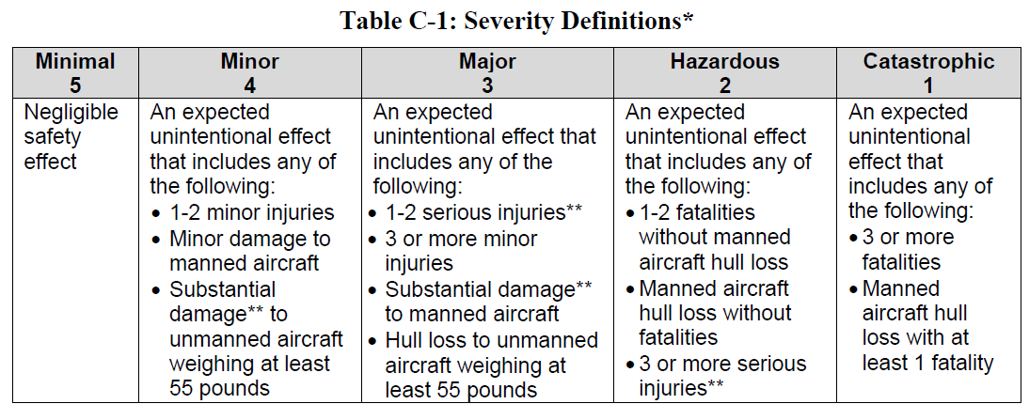
Probability of “Casualty” versus Likelihood of “Effect”
14 CFR 450 “Casualty means any serious injury or death”
FAA Order 8040.4C “Severity” means consequence or impact of a hazard’s effect in terms of degree of loss or harm
Severity Categories
Degrees of loss
None
Minor
Substantial
Hull loss
Degrees of harm
None
Minor injury
Serious injury
Fatality
Effects
Casualties
Notes:
The degrees of loss and harm are standardized between FAA Order 8040.4C, NTSB, and the FAA AIDS database except for the term “hull loss.” Both NTSB and FAA AIDS use the term “destroyed”

Slide 7
Example: Part 121 Turbulence
Likelihood of effect
1.23 e-10
1e-1
1e-2
P(casualty)
4.7 e-7
1e-3
1e-1
1e-4
1e-2
1e-5
1e-3
1e-6
1e-4
1e-7
1e-5
1e-8
1e-6
1e-9
1e-7
1e-10
Historic Risk Data from NTSB and FAA AIDS, 2008-2024
Source: GTG4 SRMD, 1-22-2026
1e-8
1e-11
14 CFR 450 Risk Limit
8040.4C Risk Limit

Slide 8

Ideas For Consideration
Collaborate with NTSB to modify the taxonomy
  Break out “debris” from the current hazard “debris/dirt/foreign object”
Modify the 14 CFR 450 definitions to align “casualty” with “aircraft accident”
  Casualty means serious injury, death, substantial damage, or hull loss

Slide 9

Questions/Discussion
Notes:
Photo of JFK airport with Manhattan in the background taken from the cockpit of a Diamond DA-40

Slide 10
Risk Partitioning
Risk ANALYSIS can use any partition
Risk ASSESSMENT via Risk Matrix can only support
  GA
  Commercial
Overall Activity
Commercial Aircraft
Group x
Notes:
A frequent error in FAA risk management is to assess the risk of various partitions using a matrix that was designed to assess the risk of commercial aviation or general aviation. This can result in overestimating risk and inhibits the Agency’s ability to prioritize hazards according to risk levels.

